Slide 1
A brief guide on DNA barcoding

Slide 2
Introduction

Slide 3
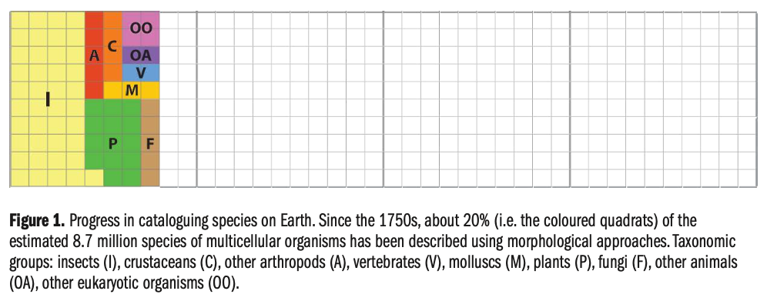
The need for a species identifiaction pipeline
Eukariotic species on Earth: 3.000.000 – 100.000.000
How many species are going/are at risk of going extinct?
?
?
?
source: THE GLOBAL TAXONOMY INITIATIVE 2020: A STEP-BY-STEP GUIDE FOR DNA BARCODING

Slide 4



The need for a species identifiaction pipeline
Development of a pipeline with the following considerations:
Can be standardized
Minimal information required for identification
Cost-effective
Fast
Reproducible
Taxonomists
Need to identify species

Slide 5
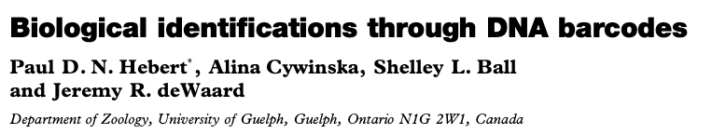
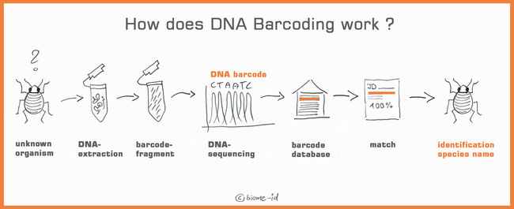
DNA barcoding enters the stage
source: biome

Slide 6
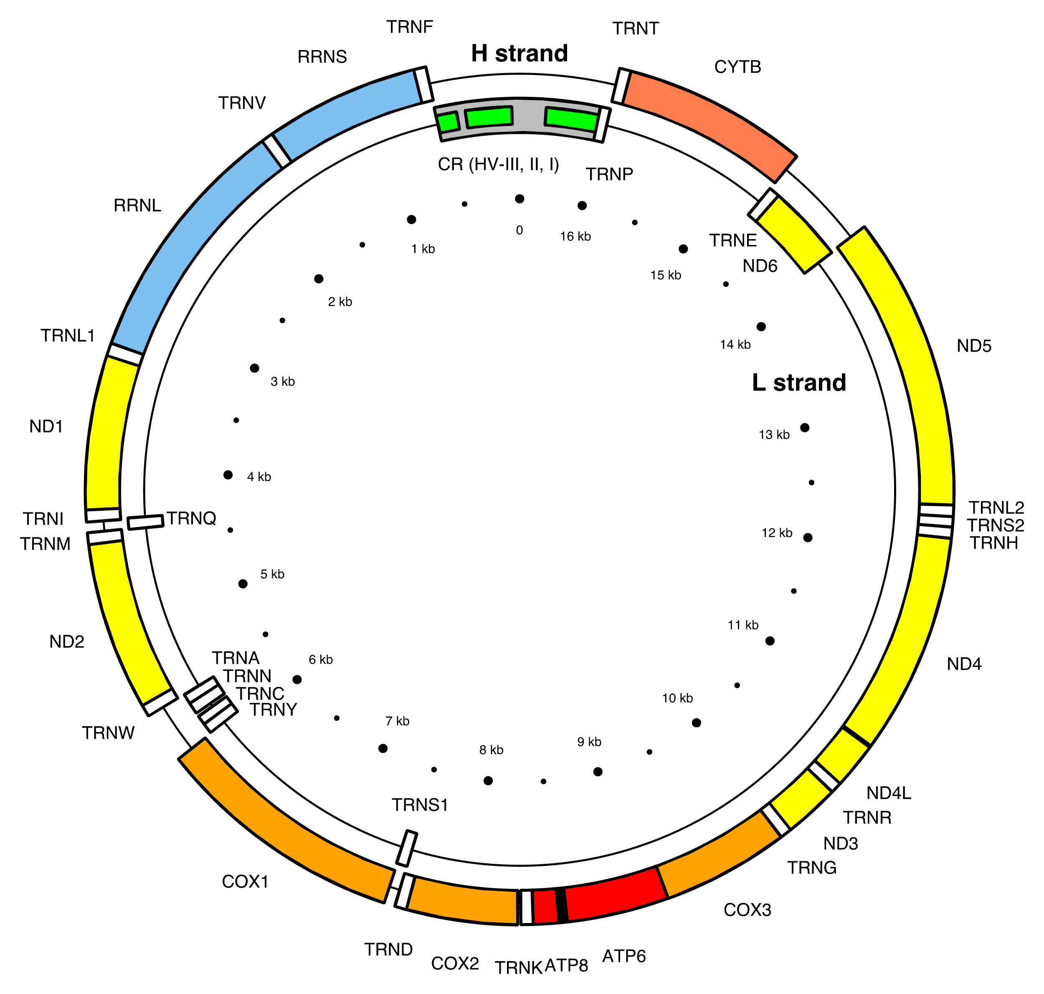
The metazoan target sequence
Why this sequence?
High copy number / cell
No recombination
Appropriate mutational rate for species delineation
Lack on non-coding sequences
~650 nt
chloroplastid sequence (rbcL, matK)
nuclear sequence (internal transcribed spacer sequence - ITS)
by Emmanuel Douzery

Slide 7
Limitations of DNA barcoding
DNA barcoding ≠ phylogenetic reconstruction
Recently diverged species not distinguishable
Hybdridization events are unresolvable
Heteroplasmy within individual
‘Universal’ primers not so universal
Sample age can impede recovery of COI sequences

Slide 8
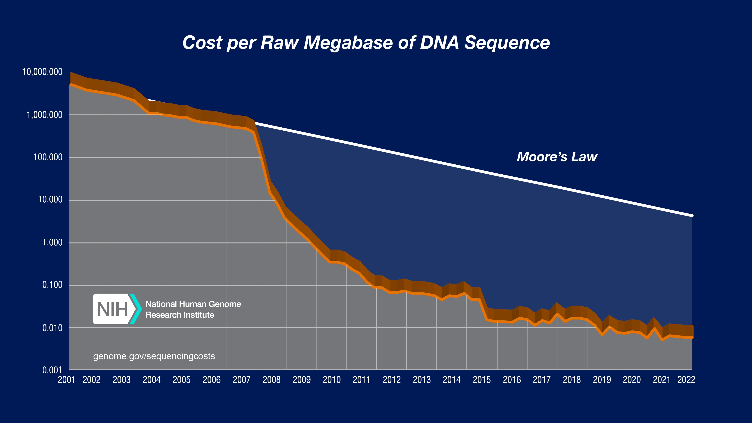
Detour into genome skimming
Phylogenetic marker
deep sequencing
chromosome
Next-generation sequencing
Oxford Nanopre
reads
Phylogenetic marker
skimming
chromosome
source: NCBI
reads

Slide 9
File-formats associated with DNA barcoding

Slide 10
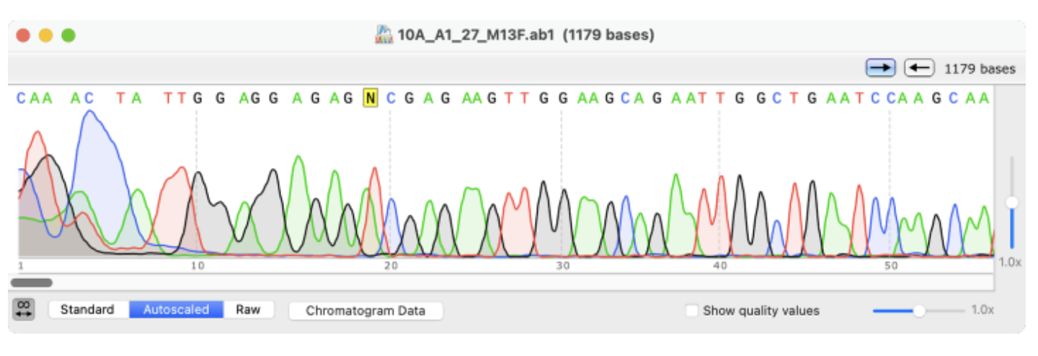
.ab1 (Applied Biosystems Trace File)
Binary file
Sanger sequencing chromatogram results
Raw chromatogram
Quality scores
Processed base calls
Specialized programs used for visualizing

Slide 11
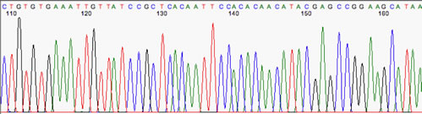
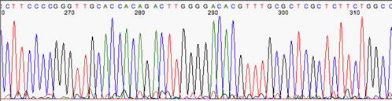
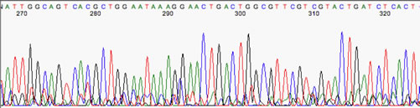
Features of a good run
Evenly spaced peaks, lack of baseline ‘noise’
Some baseline ‘noise’, still OK
Too much baseline ’noise’
source: University of North Texas, Dept of Biological Sciences

Slide 12
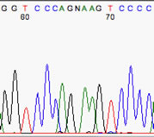
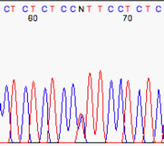
Other systematic errors
Misscalling a peak
Missplacing peaks
Heterozygous peaks
Loss of resolution at the ends
source: University of North Texas, Dept of Biological Sciences

Slide 13
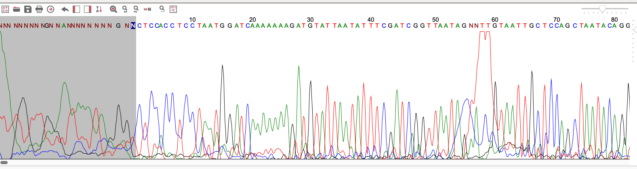
Trim the ends of the trace files
Search for undetermined bases at the 5` and 3` end
Mask upstream and downstream
Inspect the presence of other undeteremined bases using the
Export as a Staden file

Slide 14
Build contigs of paired sequences
Forward
Reverse
Consensus

Slide 15
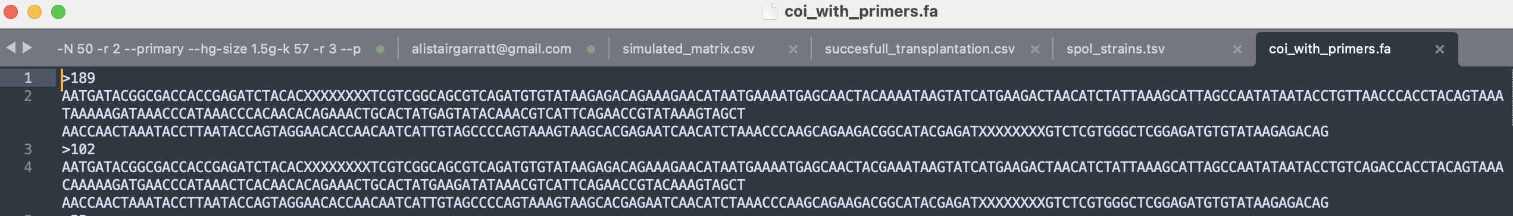
.fasta
Text file
Stores sequence data (both nucleotide, and amino acid)
Text editors can be used to visualize it

Slide 16
Newick format
Text file
Stores phylogenies
Text editors can be used to visualize it
Structure: nested parentheses, nodes, branch lengths, root
|--- A
|----|
| |--- B
|----|
| | |--- C
| |----|
-| |--- D
|
|------------- E
((A,B),(C,D)E);

Slide 17
Comparison to a reference library

Slide 18

Introduction to BOLD
Database to store and analyze barcoding sequences

Slide 19
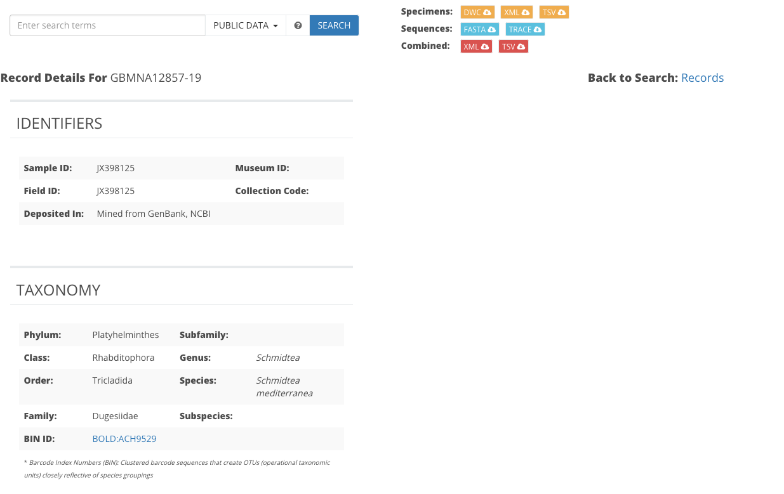
Example entry for S.mediterranea
For downloading

Slide 20

Sidenote for controls
Positive control: we know what effect to expect
Negative control: we know that effect should not be present
Possibly sister species
Possibly sister species
Sample of interest
Possibly sister species
Definitely not sister species
Definitely not sister species

Slide 21







Distinguishing species
Has hair?
Has two ears?
Lives in water?
Has a endoskeleton?

Slide 22
Distinguishing species
ACGTGTCATC…
AAGCGTCATC…
Multiple sequence alignment
AGATGTTATC…
TCGAGTCAAG…
TTATGCCTTA…

Slide 23
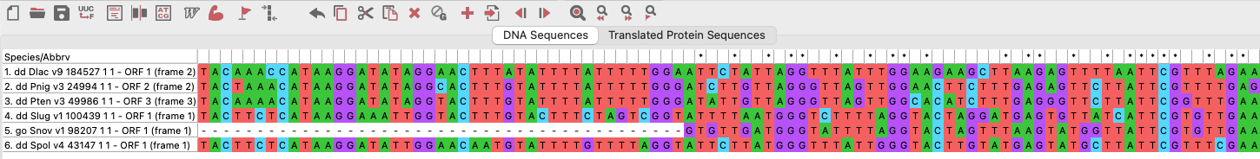
Introduction to multiple sequence alignments using MEGA
alignment run
gaps
conserved
variable

Slide 24
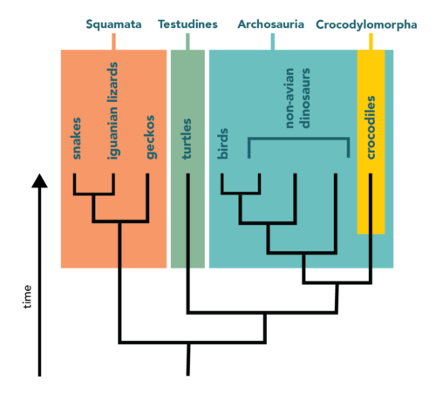
Introduction to phylogenetic trees
Clade
Clade
Clade
Clade
Visual representation of a evolutionary hypothesis
Tips/leaf/OTU
Has hair?
Has two ears?
Lives in water?
Has a endoskeleton?
Node
Branch
LCA
source: berkley.edu

Slide 25
The end

